Slide 1


PIZZA HUT
UNDER THE GUIDANCE OF :
POOJA MEHTA
SUBMITTED BY:
RAM KUMAR P BHAVANAVIKA R N BHAGYA T

Slide 2

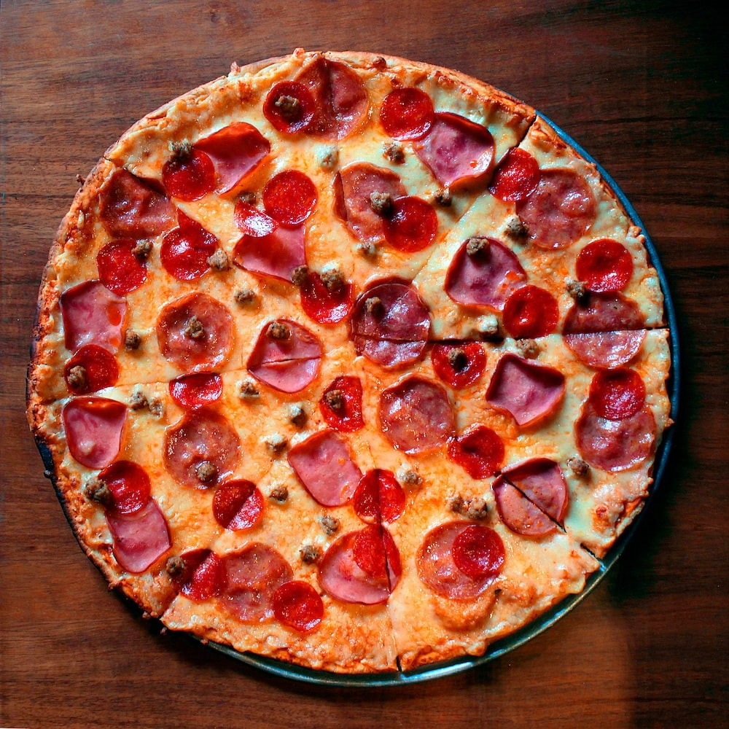
INTRODUCTION
The Pizza Hut App project has been developed using Angular TypeScript, Spring Boot, and MySQL Database. We are providing full-stack projects with source code, database, and documentation. The Pizza Hut App is an application designed to manage online pizza ordering and reservations. This application is simple, efficient, and user-friendly.
The main objective of the Pizza Hut App is to provide users with a seamless way to book bus orders online. There are two roles in this project: Admin and User.
Admin can manage activities such as adding pizza items, adding stops, and adding schedules in their admin page. They have full control over managing bus details, schedules, and stops to ensure smooth operations.
Users can search for available pizza items, book orders, and view their booking history.
This full-stack Angular TypeScript and Spring Boot project makes the pizza ordering process automated and efficient, eliminating the need for manual reservation handling. It simplifies schedule management, seat availability tracking, and booking management in a hassle-free manner.

Slide 3
PROJECT OBJECTIVE
🔹 Convenient & User-Friendly – Browse and order pizzas online with ease.
🍕 Seamless Ordering Experience – A streamlined system for selecting, customizing, and purchasing pizzas hassle-free.
⚡ Efficient & Secure – Ensures a smooth ordering experience with secure transactions and user-friendly navigation.
🔎 Quick Search – Find available pizza items and place orders with just a few clicks.
The Pizza Hut App allows users to:
✔ Register and log in securely. ✔ Browse the menu and search for pizzas based on categories, ingredients, or price. ✔ Customize pizzas with toppings and add them to the cart. ✔ Place orders and track them in real-time. ✔ View order history and manage their profile.
Admins can:
✔ Add and manage pizza items, ingredients, and offers. ✔ Monitor and manage customer orders and delivery status. ✔ Oversee payments and transactions.
This full-stack application provides an efficient and automated online pizza ordering system, replacing traditional methods and enhancing the overall user experience.

Slide 4


TECHNOLOGY USED
SPRING BOOT
JAVA
Spring Boot is used To handle the backend operations efficiently.It Provides RESTful APIs for user authentication, with SpringData JPA and hibernate, it ensures seamless interaction with the MySQL Database database.
Java is an object-oriented programming (OOP) language, which means it supports the principles and concepts of object-oriented programming.
JaVa
HTML
angular
HTML, which stands for HyperText Markup Language, is the standard markup language used for creating and structuring web pages.
ANGULAR
Angular is a TypeScript-based framework that uses HTML, CSS, and JavaScript to build robust and scalable single-page applications.
Postman (for API testing)
POSTMAN
TypeScript
Postman is a popular collaboration platform and toolset used by developers to build, test, and document APIs
Typescript is a widely used Programming language that builds on JavaScript by adding static typing

Slide 5
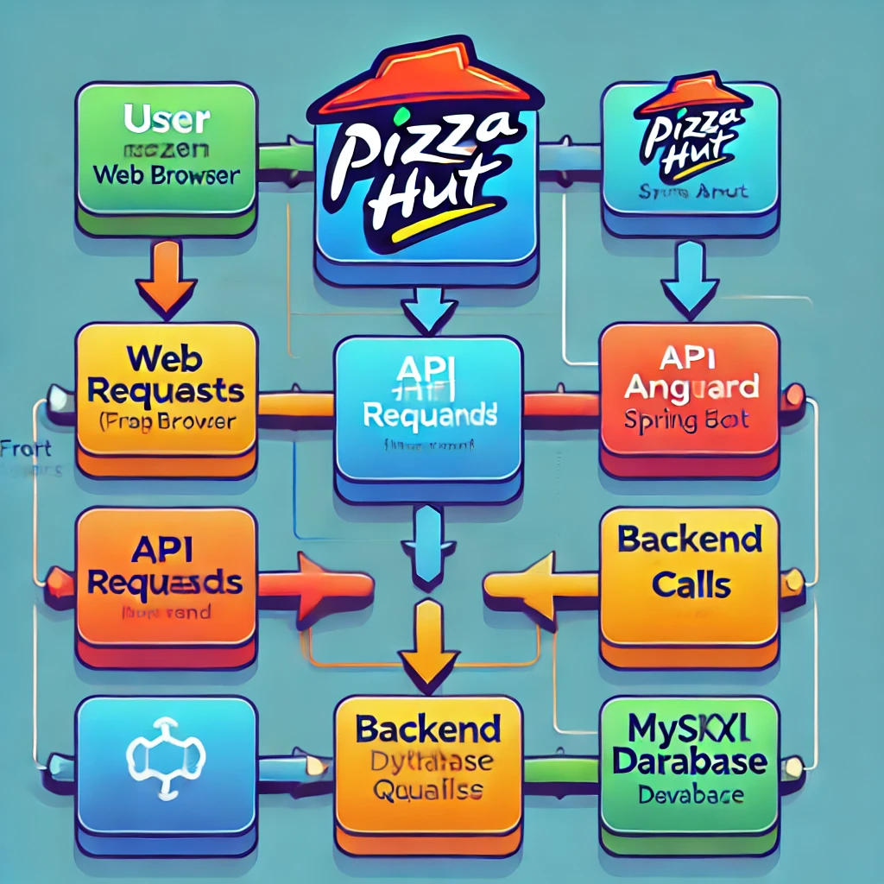
PROPOSED SYSTEM
🔹 Seamless & User-Friendly Experience – Search, select, and book bus orders effortlessly from the comfort of your home.
🚀 Powerful Full-Stack Solution – Built with Eclipse Java Spring Boot Spring Boot, Spring Data JPA, MySQL Database, and Angular TypeScript for efficiency and scalability.
⚡ Fast & Secure Backend – Eclipse Java Spring Boot Spring Boot ensures rapid development and high-performance processing.
🔗 Smooth Database Interaction – Spring Data JPA simplifies communication with MySQL Database for seamless data management.
🎨 Dynamic & Interactive UI – Angular TypeScript delivers a modern, responsive, and engaging booking experience.
✅ Streamlined Reservation Management – Simplifies booking for passengers and optimizes operations for administrators.

Slide 6
REQUIRED SPECIFICATIONS
HARDWARE CONFIGURATION | SOFTWARE CONFIGURATION
Operating System : Windows 10 and above | Software IDE: Eclipse, Postman, MySQL, VS Code.
Hard Disk: 500 GB | Language: JAVA, Type Script, HTML, CSS
RAM: 8 GB | Front End: Angular
 | Back End: Spring Boot, MySQL.

Slide 7
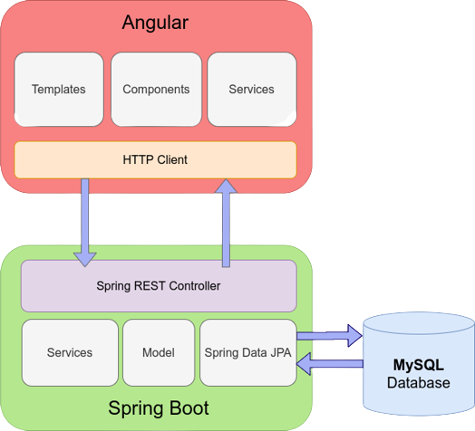
CONNECTION TO DATABASE

Slide 8
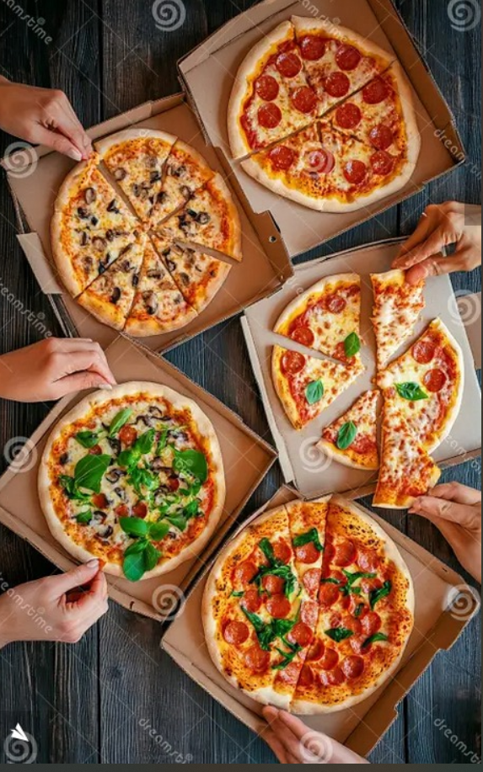
MODULES
USER: Customers can browse the menu, customize orders, and make payments.
ADMIN: Manage menu items, orders, and customer data.
MENU MANAGEMENT: Add, update, and remove pizza items, sides, and drinks.
ORDER MANAGEMENT: Update order status and show all orders list.

Slide 9
SPRING NOTATATIONS
@Controller : | The @Controller annotation indicates that a particular class serves the role of a controller. Spring Controller annotation is typically used in combination with annotated handler methods based on the @RequestMapping annotation.
@Autowired | The @Autowired annotation provides more fine-grained control over where and how auto-wiring should be accomplished. Autowiring feature of spring framework enables you to inject the object dependency implicitly. It internally uses setter or constructor injection.
@RequestMapping | The @RequestMapping is one of the most common annotation used in Spring Web applications. This annotation maps HTTP requests to handler methods of MVC and REST controllers.
@Entity | The @Entity annotation specifies that the class is an entity and is mapped to a database table.
@Table | The @Table annotation is used to create a table in database.
@JoinColumn | The @JoinColumn is used to specify a column for joining an entity association or element collection.

Slide 10
SPRING NOTATATIONS
@PutMapping | The @PutMapping is used for update the records.
@PostMapping | The @PostMapping is used to create a resource Mapping.
@GetMapping | The @GetMapping is used to read all the inserted records.
@DeleteMapping | The @DeleteMapping is used to delete the records.
@PathVariable | The @Path Variable annotation is used to extract the value from the URL.
@RequestParam | The @RequestParam annotation is used to read the form data and bind it automatically to the parameter present in the provided method.

Slide 11
SPRING NOTATATIONS
@Request Body | The @RequestBody annotation is applicable to handler methods of spring controller. spring should deserialize a request body into an object.
@OneToOne Mapping | The @OneToOne JPA annotation is used to map the source entity with the target entity, Hibernate maps the tables in your database to the Entity classes in your application.
@OneToMany Mapping | The @OneTo-Many relationship between table A and table B indicates that one row in a table A link to many rows in table B but one row in table B links to only one row in table A.
@ManyToOne Mapping | The @Many-to-One mapping means that many instances of this entity are mapped to one instance of another entity.

Slide 12
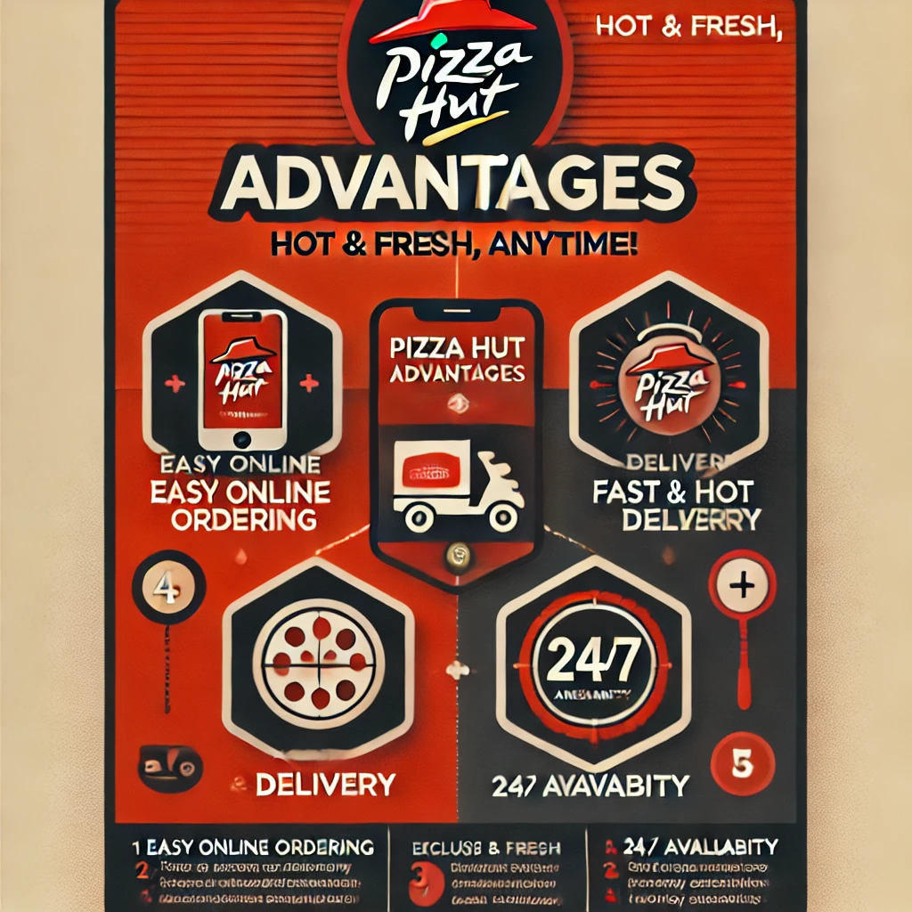
ADVANTAGES

Slide 13
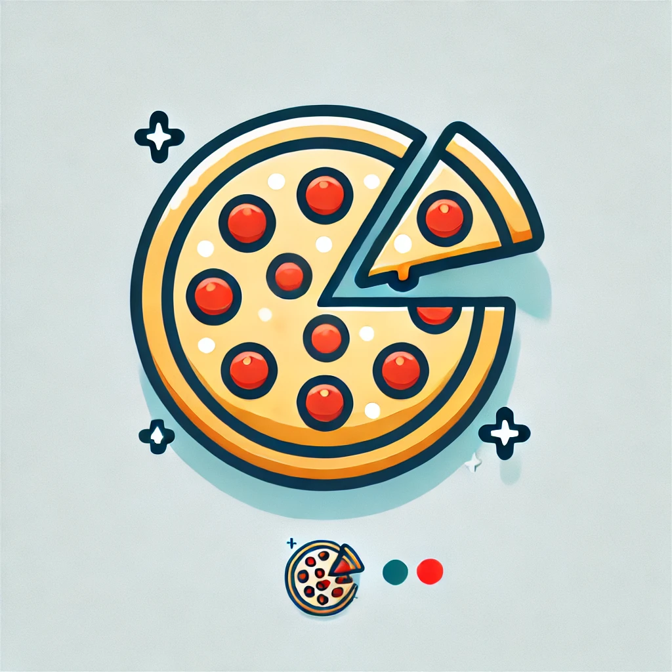
CONCLUSION
The Pizza Hut App revolutionizes online pizza ordering by offering a seamless, efficient, and user-friendly experience. With features like secure login, seat selection, and booking management, it ensures convenience for passengers while enabling administrators to manage pizza items and schedules effortlessly. Leveraging modern technologies, this platform provides a scalable, reliable, and hassle-free solution for travel planning, making public transportation more accessible and efficient.

Slide 14
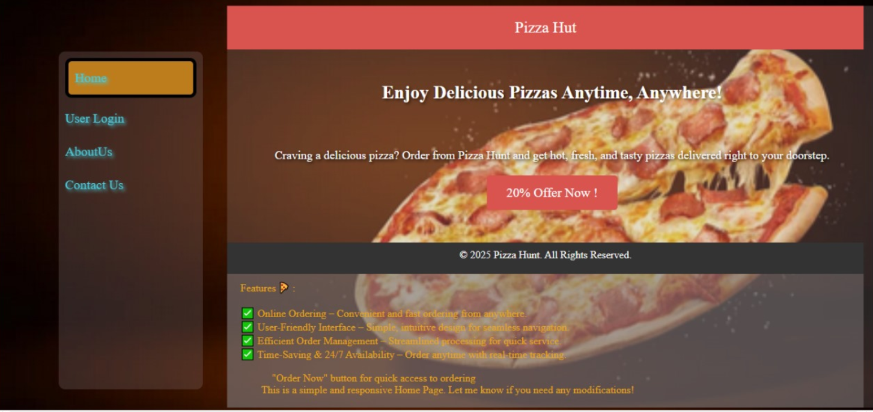
Home page

Slide 15
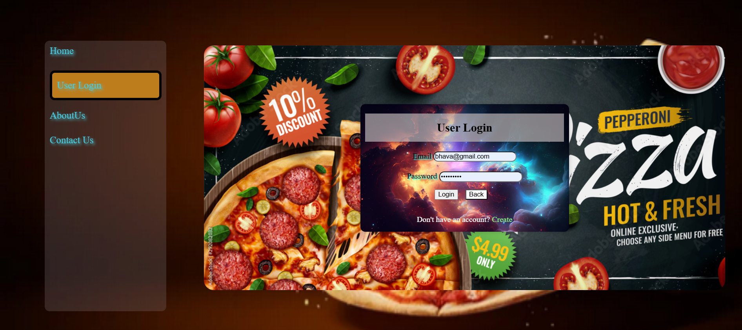
User login

Slide 16
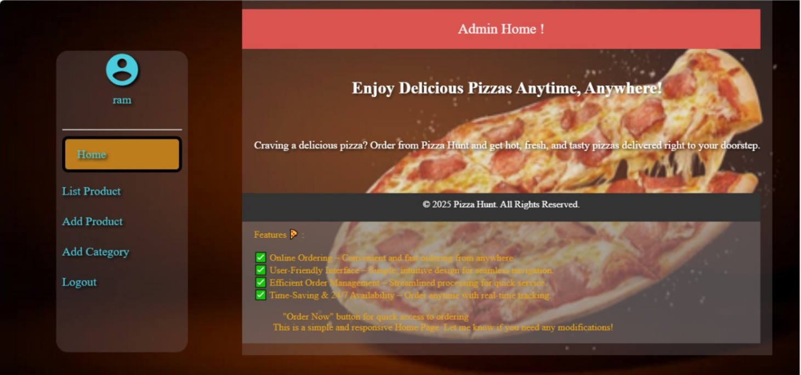
Admin home

Slide 17
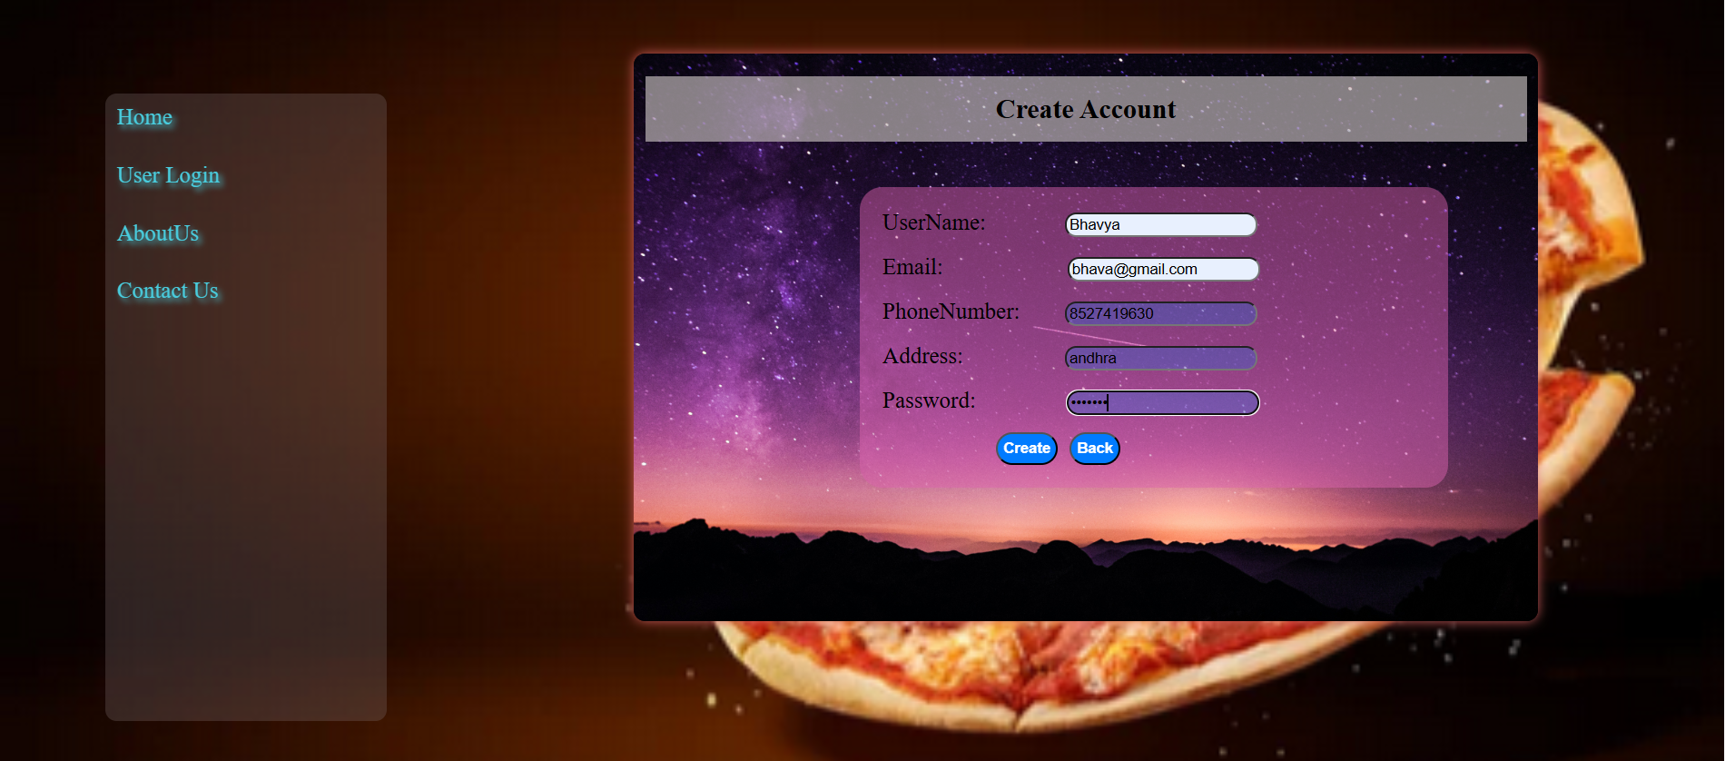
REGISTRATION FORM

Slide 18
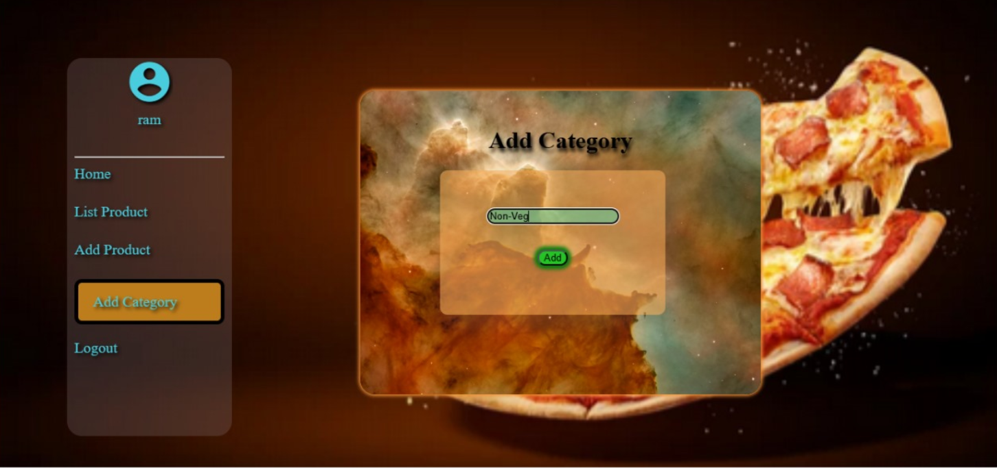
Add category page

Slide 19
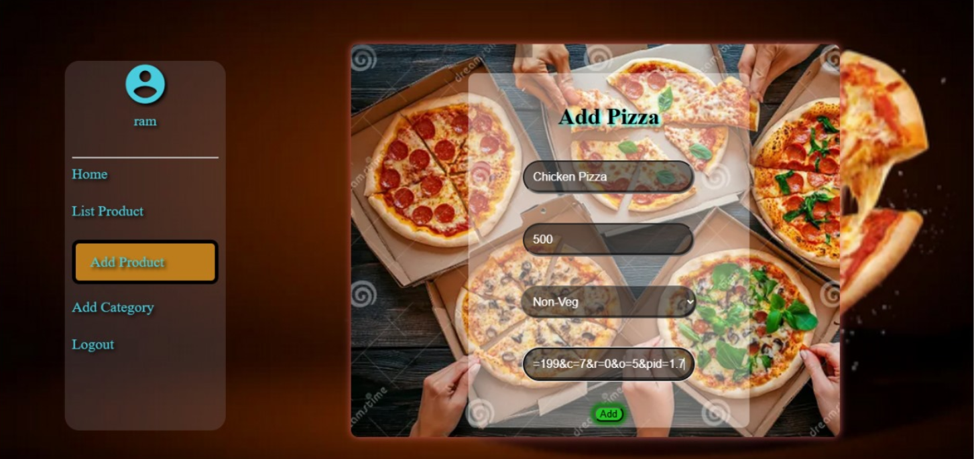
Add pizza

Slide 20
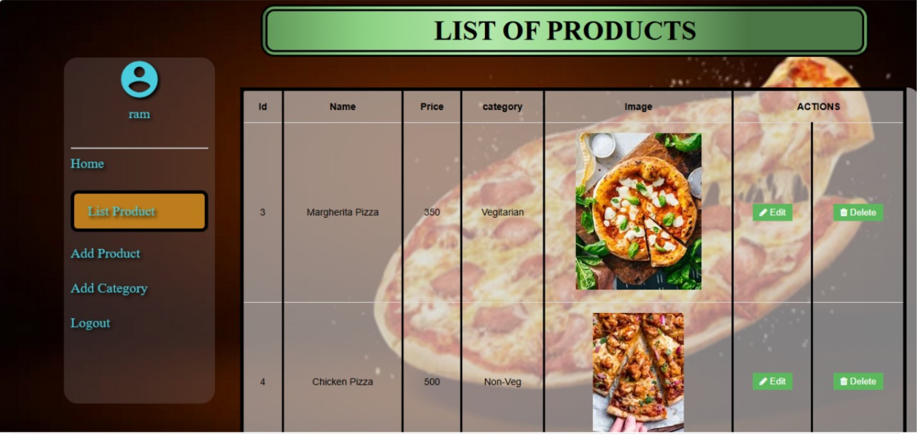
Menu page

Slide 21
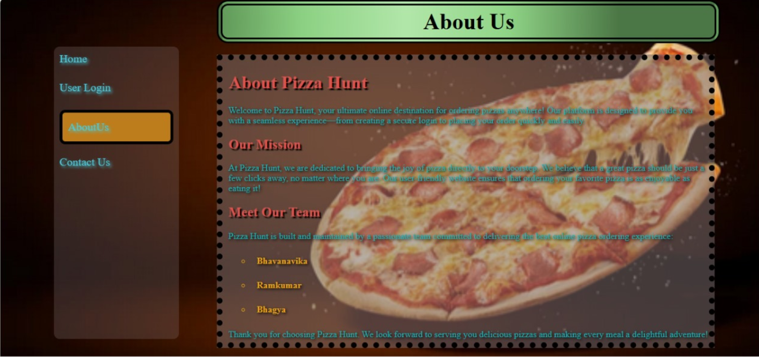
About us

Slide 22
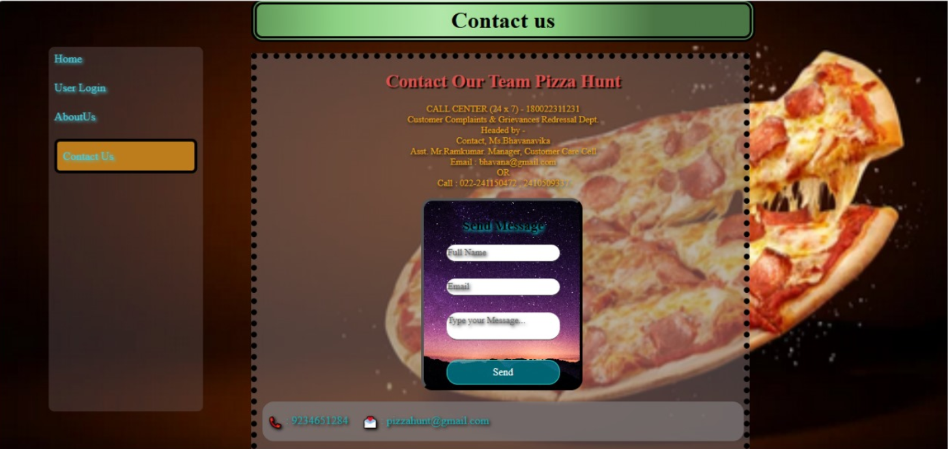
Contact us

Slide 23
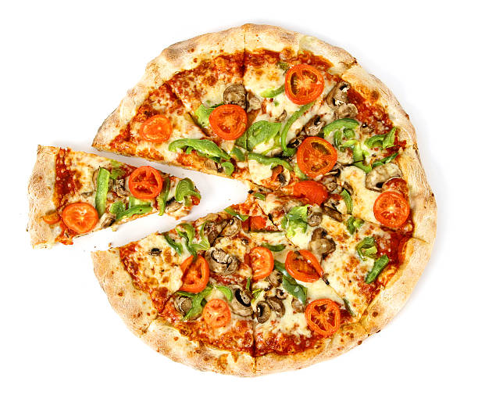
THANK YOU

